Slide 1
TELECOM CUSTOMER CHURN
DSIA Capstone Project
Ashish Nambudiri

Slide 2
AGENDA
Define
Design
Deliver
Summary and Next Steps

Slide 3





CUSTOMER CHURN - THE VICIOUS CYCLE!!
Customer stops using the company’s services
Direct Revenue Loss
Churned customers may take away other loyal customers with them
Added Pressure to add more customers
More expensive to add new customers than to retain existing ones

Slide 4

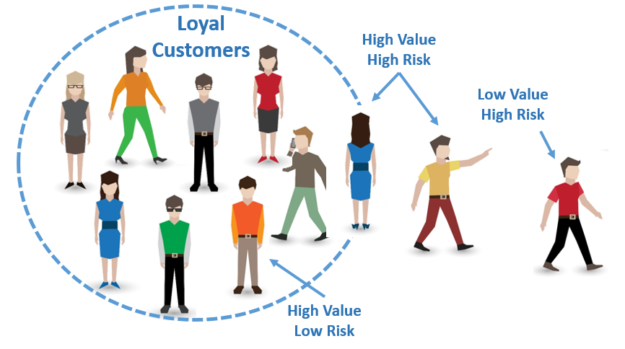
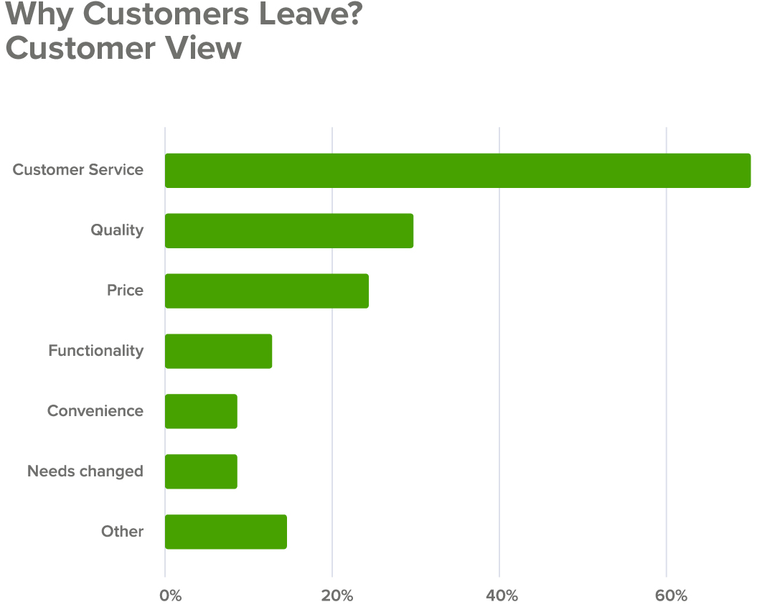

THE BUSINESS QUESTION
How can we reduce churn and improve customer retention?
Predict in advance customers with high risk of churning
Identify factors that most likely influence customer churn
Proactive action on insights to improve customer retention
Massive Savings and Increased Revenue

Slide 5
THE VALUE PROPOSAL $$$
Assumptions
Acquiring a new customer in the telco industry costs $300
Retaining an existing customer is one sixth the cost, i.e. $50
The current customer base is 350,000
Predicted Outcome | Actual Outcome | Cost per Customer
No Churn | Churn | $300
Churn | No Churn | $50
Churn | Churn | $50
No Churn | No Churn | $0
Improve Accuracy
Minimize Cost
If we’re able to save just $10 per customer by virtue of accurate predictions it will translate to a savings of $3.5 million!!!

Slide 6
THE DATASET
7043 unique customer records
Customers who left within the last month – Churn or No Churn
Services each customer has signed up for – phone, multiple lines, internet, online security, online backup, device protection, tech support, and streaming TV and movies
Customer account information – how long they’ve been a customer, contract, payment method, paperless billing, monthly charges, and total charges
Demographic info – gender, age range, and if they have partners and dependents

Slide 7
THE DATASET
7043 Unique Telecom Customers
Predictor Variable – Churn (Yes/No)
Services signed up for:
Phone
Multiple lines
Internet
Online security
Online backup
Device protection
Tech support
Streaming TV
Streaming Movies
Account Information:
Tenure
Contract
Payment method
Paperless billing
Monthly charges
Total charges
Demographics:
Gender
Age Range
Partners
Dependents

Slide 8
THE DATA QUESTIONS
Based on the usage and demographic information about existing and past customers, can we predict customers that are likely to churn in the future?
Can we find out from the data the factors that most likely influence customer churn?

Slide 9
AGENDA
Define
Design
Deliver
Summary and Next Steps

Slide 10



THE PIPELINE AND APPROACH
Business Question
Tell the Story
Validate
Model
Explore
Clean
Pre Process
Wrangle

Slide 11
AGENDA
Define
Design
Deliver
Summary and Next Steps

Slide 12
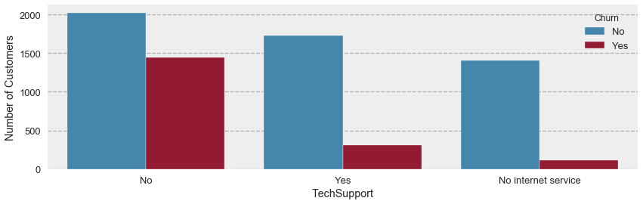
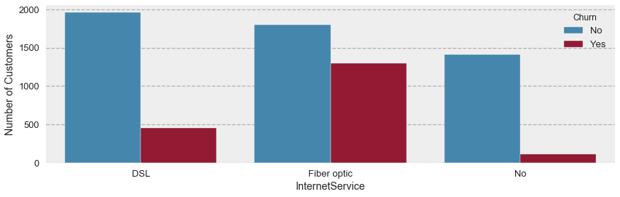
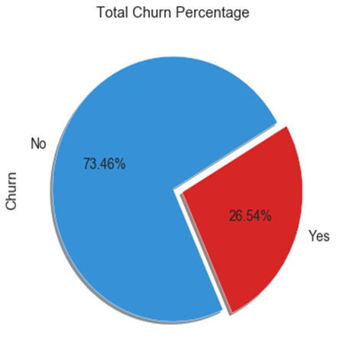
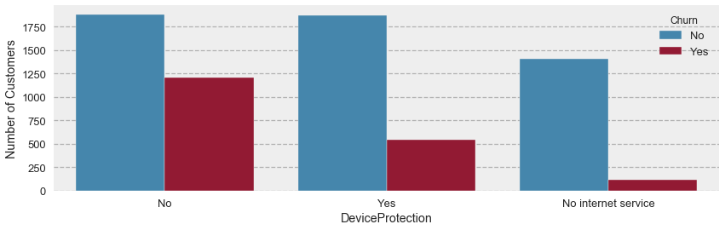
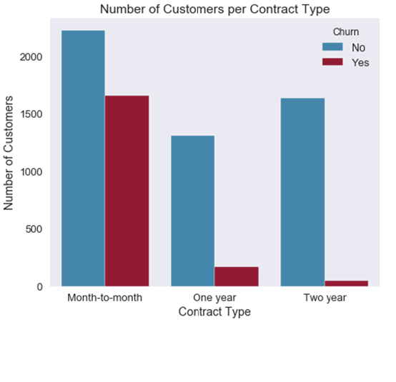
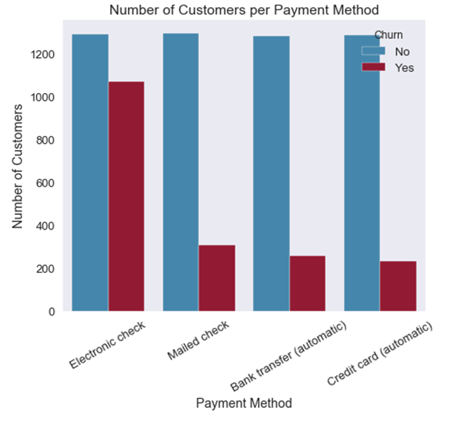
Customers with no Tech Support tend to churn more
What story does the Data tell?
Customers with Fiber Optic Internet churn more than ones with DSL
Some interesting observations
Customers with Device Protection plans tend to stay longer
% of churn instances in the data set
Customers on Month-to-Month Contract churn more than those with longer contracts
The Electronic Check payment system creates more churn customers than other payment methods

Slide 13
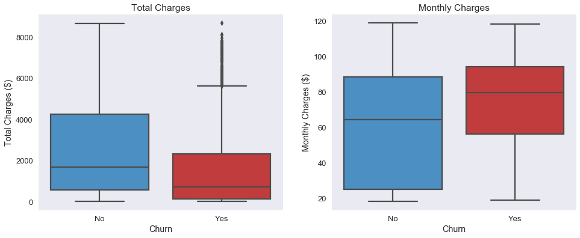
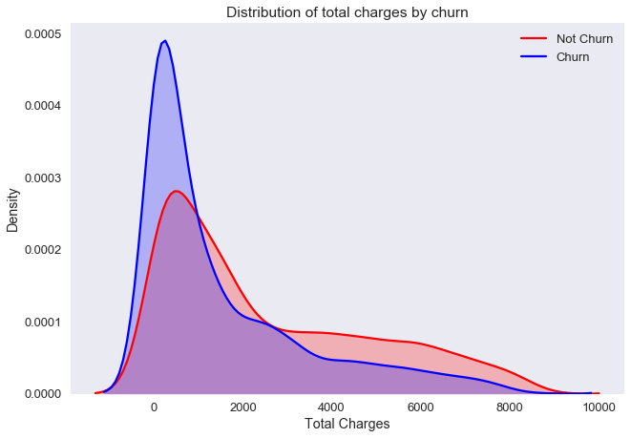
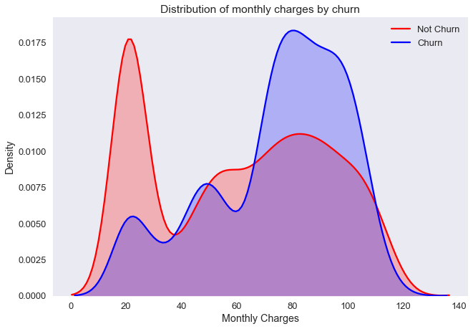
Churn Customers pay Lower Total Charges but Higher Monthly Charges on an average

Slide 14
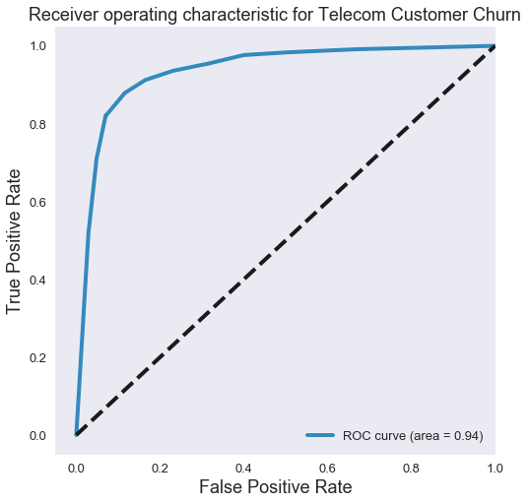
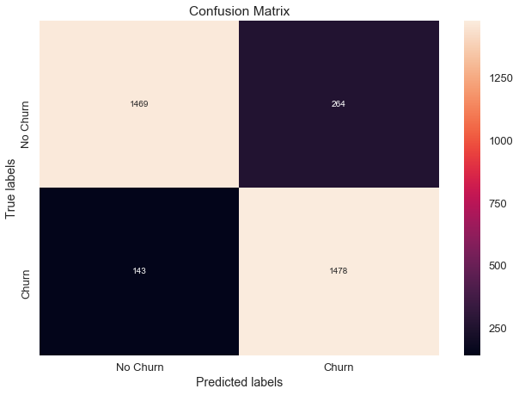
MODEL EVALUATION AND SELECTION
Model | Accuracy
Naive Bayes | 0.75
Logistic Regression | 0.77
KNN | 0.74
Decision Tree | 0.85
Random Forest | 0.87
SVC | 0.76
Random Forest Classifier gives the most accurate results - 87% accuracy

Slide 15
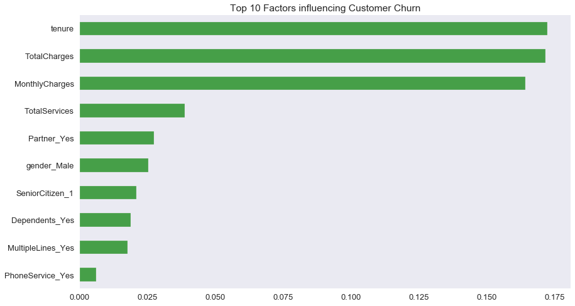
TOP 10 FACTORS INFLUENCING CHURN

Slide 16
AGENDA
Define
Design
Deliver
Summary and Next Steps

Slide 17
SUMMARY AND INSIGHTS
Customer Churn can be predicted with 87% accuracy
Churn Customers
Tend to lean towards month-to-month contracts and opt for one or two service
Pay a higher monthly average with electronic checks
Choose the fiber optic internet service, with no online security, no online backup, no device protection, and no tech support
Seem to mostly not have a partner or dependents
Potential Problems
Likely issue with fibre optic internet service
Month-to-month contracts have higher monthly charges
Possible problem with the electronic check payment option

Slide 18
ESTIMATED COST SAVINGS
Translating the cost assumptions into the Confusion Matrix:
Predict 'no churn', customer churns > costs $300
Predict 'churn', customer churns > costs $50
Predict 'churn', customer doesn’t churn > costs $50
Predict 'no churn', customer doesn’t churn > costs $0
Savings per Customer as per the RFC model: $35.15
Savings across the entire 350k customer base: 350,000 * 35.15 = $12,303,220.04

Slide 19
NEXT STEPS
Deploy the Model
Identify customers likely to churn and reach out to them
Investigate potential problem areas discovered in data exploration:
Fibre optic internet service
Revise month to month plans
Review the electronic check payment option
Publish insights on a dashboard

Slide 20
REFERENCES
Code Repository on GitHub:
https://github.com/DSIA-Education/DSIA-SYD-March-2019/tree/master/Ashish/Final%20Capstone%20Project
Project Notebooks:
Telecom Customer Churn 1 - Introduction and Data Import.ipynb
Telecom Customer Churn 2 - EDA.ipynb
Telecom Customer Churn 3 - Data Encoding and Preparation.ipynb
Telecom Customer Churn 4 - Modelling and Business Impact.ipynb https://github.com/DSIA-Education/DSIA-SYD-March-2019/tree/master/Ashish/Final%20Capstone%20Project/Notebooks
Project Documentation:
Telco Customer Churn.docx https://github.com/DSIA-Education/DSIA-SYD-March-2019/tree/master/Ashish/Final%20Capstone%20Project/Presentation

Slide 21


